Slide 1
WX-11: retain the coarser distribution
DL_2018_0034 | DF18-00421 | Wexanthel Medicines | Miguel Serrano | 07/24/2018 | FINAL final | Durnesswick Laboratories Inc

Slide 2
Recommendation retained
Wexanthel Medicines retained the coarser particle-size distribution.
The micronised pilot lot formed a compact cake.
Smaller particles did not give the preferred handling behavior.
Durnesswick Laboratories Inc | Confidential 2
Notes:
FINAL final working revision: handoff wording now emphasizes recovery after standing rather than initial appearance.

Slide 3
Vehicle ladder: physical behavior beside capacity
Vehicle | Equilibrium solubility (mg/mL) | Appearance at 10 mg/mL loading | 24 h physical stability (10 mg/mL)
0.5% methylcellulose | 0.68 | Suspension, settles <1 h | Redisperses on shaking
0.5% HPMC / 0.1% Tween 80 | 5.9 | Fine suspension | Redisperses on shaking
20% HP-β-CD in water | 0.33 | Fine suspension | Caking at 24 h
PEG400/water 30:70 | 0.54 | Fine suspension, easily redispersed | Settles; redispersible
10% DMSO / 90% corn oil | 1.2 | Suspension, settles <1 h | Settles; redispersible
Labrasol/PEG400 1:1 | 2.2 | Suspension, settles <1 h | Settles; redispersible
5% NMP / 15% Solutol HS15 / 80% water | 0.59 | Fine suspension, easily redispersed | Caking at 24 h
pH 4 citrate buffer | 1.1 | Fine suspension | Settles; redispersible
Durnesswick Laboratories Inc | Confidential 3

Slide 4
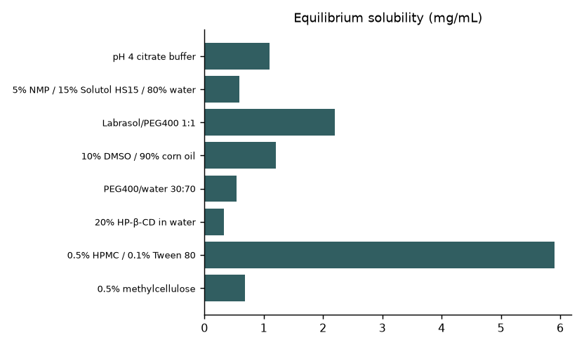
Equilibrium capacity is only part of the choice
Durnesswick Laboratories Inc | Confidential 4
Notes:
Target loading 10 mg/mL. This chart does not measure dilution behavior or particle-size distribution.

Slide 5
Work package history
Started 06/01/2018; interim discussion 06/27/2018; completed 07/24/2018.
Miguel Serrano prepared the comparison under Julia Carver’s development lead.
Lena Patel supported the practical dosing handoff.
Durnesswick Laboratories Inc | Confidential 5

Slide 6
Particle-size comparison: qualitative conclusion
Coarser pilot lot retained for dosing.
Recoverability after settling is more useful than a fine appearance alone.
Micronised pilot lot settled into a compact cake.
The handling penalty outweighed the expected benefit of size reduction.
Durnesswick Laboratories Inc | Confidential 6
Notes:
No D10, D50 or D90 measurements in µm are supplied. The solubility chart is not a particle-size plot.

Slide 7
Redispersion is a use condition
Compare the settled preparation before and after the defined mixing step.
Note base adhesion and hard sediment that remains.
Uniform appearance during active mixing does not establish recovery after standing.
Durnesswick Laboratories Inc | Confidential 7

Slide 8
Vehicle observations relevant to recovery
Vehicle | Appearance at 10 mg/mL loading | 24 h physical stability (10 mg/mL)
0.5% methylcellulose | Suspension, settles <1 h | Redisperses on shaking
0.5% HPMC / 0.1% Tween 80 | Fine suspension | Redisperses on shaking
20% HP-β-CD in water | Fine suspension | Caking at 24 h
PEG400/water 30:70 | Fine suspension, easily redispersed | Settles; redispersible
10% DMSO / 90% corn oil | Suspension, settles <1 h | Settles; redispersible
Labrasol/PEG400 1:1 | Suspension, settles <1 h | Settles; redispersible
5% NMP / 15% Solutol HS15 / 80% water | Fine suspension, easily redispersed | Caking at 24 h
pH 4 citrate buffer | Fine suspension | Settles; redispersible
Durnesswick Laboratories Inc | Confidential 8

Slide 9
Keep vehicle and size as separate variables
The ladder distinguishes redispersible preparations from caking preparations.
The particle-size follow-up independently identified the micronised compact cake.
Do not assign that failure to a ladder row without the linked recipe card.
Durnesswick Laboratories Inc | Confidential 9

Slide 10
Decision consequences
Item | Instruction
Material condition | Retain coarser distribution; no micronised substitution
Size description | Report future measured distributions in µm
Settled preparation | Resuspend before withdrawal
Material change | Repeat recovery assessment before extending use
Durnesswick Laboratories Inc | Confidential 10

Slide 11
Complete decision; further process work
The client’s choice of coarser material is complete.
The compact cake explains the rejection of micronisation.
This deck sets no numerical size specification.
Transfer-scale preparation and storage claims need supporting observations.
Durnesswick Laboratories Inc | Confidential 11

Slide 12
Handoff to Lena Patel
Carry material condition and resuspension instructions together.
Retain both pilot-lot observations so the rejected route remains understandable.
Agree container geometry and mixing method before larger preparation.
Durnesswick Laboratories Inc | Confidential 12

Slide 13
Final position / working revision retained
Coarser material retained; micronisation is not the default next step.
Future changes should address recovery, concentration and manufacturability together.
FINAL final wording: “redispersible after standing” replaces “fine suspension” in the handoff.
Durnesswick Laboratories Inc | Confidential 13
Notes:
Presentation wording revised; the scientific choice is unchanged.

